Slide 1
NHẬP MÔN ỨNG DỤNG DI ĐỘNG
BUỔI 3 PHÁT TRIỂN ỨNG DỤNG DI ĐỘNG NATIVE ANDROID
GVGD: ThS. Huỳnh Tuấn Anh

Slide 2
Outline
Introduction
Android OS
Android and Ecosystem
Android Architecture
Android Application Development
Hello World

Slide 3
1.1 Android OS
History
October 2003, Android, Inc. was founded in Palo Alto, California by Andy Rubin, Rich Miner, Nick Sears, and Chris White.
In July 2005, Google acquired Android Inc. for at least $50 million, whose key employees, including Rubin, Miner and White.
November 5, 2007, the Open Handset Alliance, a consortium of technology companies including Google, device manufacturers. That day, Android was unveiled as its first product.
October 2008, The first commercially available smartphone running Android 1.0 was the HTC Dream.
In 2010, Google launched its Nexus series of devices –, and built by manufacturing partners.
Notes:
Android, Inc. was founded in Palo Alto, California in October 2003 by Andy Rubin (co-founder of Danger),^{[25]} Rich Miner (co-founder of Wildfire Communications, Inc.),^{[26]} Nick Sears (once VP at T-Mobile),^{[27]} and Chris White (headed design and interface development at WebTV^{[13]}) to develop, in Rubin's words, "smarter mobile devices that are more aware of its owner's location and preferences".^{[13]} The early intentions of the company were to develop an advanced operating system for digital cameras. Though, when it was realized that the market for the devices was not large enough, the company diverted its efforts toward producing a smartphone operating system that would rival Symbian and Microsoft Windows Mobile.^{[28]} Despite the past accomplishments of the founders and early employees, Android Inc. operated secretly, revealing only that it was working on software for mobile phones.^{[13]} That same year, Rubin ran out of money. Steve Perlman, a close friend of Rubin, brought him $10,000 in cash in an envelope and refused a stake in the company.^{[29]}
In July 2005, Google acquired Android Inc. for at least $50 million, whose key employees, including Rubin, Miner and White, stayed at the company after the acquisition.^{[11][13]} Not much was known about Android Inc. at the time, but many assumed that Google was planning to enter the mobile phone market with this move.^{[13]} At Google, the team led by Rubin developed a mobile device platform powered by the Linux kernel. Google marketed the platform to handset makers and carriers on the promise of providing a flexible, upgradable system. Google had lined up a series of hardware component and software partners and signaled to carriers that it was open to various degrees of cooperation on their part.^{[30][31][32]}
Speculation about Google's intention to enter the mobile communications market continued to build through December 2006.^{[33]} An earlier prototype codenamed "Sooner" had a closer resemblance to aBlackBerry phone, with no touchscreen, and a physical, QWERTY keyboard, but was later re-engineered to support a touchscreen, to compete with other announced devices such as the 2006 LG Prada and 2007 Apple iPhone.^{[34][35]} In September 2007,InformationWeek covered an Evalueserve study reporting that Google had filed several patent applications in the area of mobile telephony.^{[36][37]}
Eric Schmidt, Andy Rubin and Hugo Barra at a 2012 press conference announcing Google's Nexus 7 tablet
On November 5, 2007, the Open Handset Alliance, a consortium of technology companies including Google, device manufacturers such as HTC, Sony and Samsung, wireless carriers such as Sprint Nextel and T-Mobile, and chipset makers such as Qualcomm and Texas Instruments, unveiled itself, with a goal to develop open standards for mobile devices.^{[14]} That day, Android was unveiled as its first product, a mobile device platform built on theLinux kernel.^{[14][38]} The first commercially available smartphone running Android was the HTC Dream, released on October 22, 2008.^{[39]}
Since 2008, Android has seen numerous updates which have incrementally improved the operating system, adding new features and fixing bugs in previous releases. Each major release is named in alphabetical order after a dessert or sugary treat; for example, version 1.5 "Cupcake" was followed by 1.6 "Donut". In 2010, Google launched its Nexus series of devices – a line of smartphones and tablets running the Android operating system, and built by manufacturing partners. HTC collaborated with Google to release the first Nexus smartphone,^{[40]} the Nexus One. Google has since updated the series with newer devices, such as the Nexus 5 phone (made by LG) and the Nexus 7 tablet (made by Asus). Google releases the Nexus phones and tablets to act as their flagship Android devices, demonstrating Android's latest software and hardware features. From 2013 until 2015, Google offered several Google Play Edition devices over Google Play. While not carrying the Google Nexus branding, these were Google-customized Android phones and tablets that also ran the latest version of Android, free from manufacturer or carrier modifications.
From 2010 to 2013, Hugo Barra served as product spokesperson, representing Android at press conferences and Google I/O, Google’s annual developer-focused conference. Barra's product involvement included the entire Android ecosystem of software and hardware, including Honeycomb, Ice Cream Sandwich, Jelly Bean and KitKat operating system launches, the Nexus 4 and Nexus 5 smartphones, the Nexus 7^{[41]} and Nexus 10 tablets,^{[42]} and other related products such as Google Now^{[43]} and Google Voice Search, Google’s speech recognition product comparable to Apple’s Siri.^{[43]} In 2013, Barra left the Android team for Chinese smartphone maker Xiaomi.^{[44]} The same year, Larry Page announced in a blog post that Andy Rubin had moved from the Android division to take on new projects at Google.^{[45]} He was replaced by Sundar Pichai who became the new head of Android and Chrome OS,^{[46]} and, later, by Hiroshi Lockheimer when Pichai became CEO of Google.^{[47]}
In 2014, Google launched Android One, a line of smartphones mainly targeting customers in the developing world. In May 2015, Google announced Project Brillo as a cut-down version of Android that uses its lower levels (excluding the user interface), intended for the "Internet of Things" (IoT) embedded systems.^{[48]}

Slide 4
1.1 Android OS
History
From 2010 to 2013, Android ecosystem of software and hardware, including Honeycomb, Ice Cream Sandwich, Jelly Bean and KitKat operating system launches, the Nexus 4 and Nexus 5 smartphones, the Nexus 7 and Nexus 10 tablets, and other related products such as Google Now and Google Voice Search, Google’s speech recognition product comparable to Apple’s Siri.
In 2014, Google launched Android One, a line of smartphones mainly targeting customers in the developing world. Android Wear.
In May 2015, Google announced Project Brillo as a cut-down version of Android that uses its lower levels (excluding the user interface), intended for the "Internet of Things" (IoT) embedded systems.
In October 2016, Google introduced the Pixel and Pixel XL smartphones.
Notes:
Vào 3 tháng 9 năm 2013, Google công bố rằng 1 tỉ thiết bị đã được kích hoạt hiện sử dụng Android OS trên toàn cầu
Android, Inc. was founded in Palo Alto, California in October 2003 by Andy Rubin (co-founder of Danger),^{[25]} Rich Miner (co-founder of Wildfire Communications, Inc.),^{[26]} Nick Sears (once VP at T-Mobile),^{[27]} and Chris White (headed design and interface development at WebTV^{[13]}) to develop, in Rubin's words, "smarter mobile devices that are more aware of its owner's location and preferences".^{[13]} The early intentions of the company were to develop an advanced operating system for digital cameras. Though, when it was realized that the market for the devices was not large enough, the company diverted its efforts toward producing a smartphone operating system that would rival Symbian and Microsoft Windows Mobile.^{[28]} Despite the past accomplishments of the founders and early employees, Android Inc. operated secretly, revealing only that it was working on software for mobile phones.^{[13]} That same year, Rubin ran out of money. Steve Perlman, a close friend of Rubin, brought him $10,000 in cash in an envelope and refused a stake in the company.^{[29]}
In July 2005, Google acquired Android Inc. for at least $50 million, whose key employees, including Rubin, Miner and White, stayed at the company after the acquisition.^{[11][13]} Not much was known about Android Inc. at the time, but many assumed that Google was planning to enter the mobile phone market with this move.^{[13]} At Google, the team led by Rubin developed a mobile device platform powered by the Linux kernel. Google marketed the platform to handset makers and carriers on the promise of providing a flexible, upgradable system. Google had lined up a series of hardware component and software partners and signaled to carriers that it was open to various degrees of cooperation on their part.^{[30][31][32]}
Speculation about Google's intention to enter the mobile communications market continued to build through December 2006.^{[33]} An earlier prototype codenamed "Sooner" had a closer resemblance to aBlackBerry phone, with no touchscreen, and a physical, QWERTY keyboard, but was later re-engineered to support a touchscreen, to compete with other announced devices such as the 2006 LG Prada and 2007 Apple iPhone.^{[34][35]} In September 2007,InformationWeek covered an Evalueserve study reporting that Google had filed several patent applications in the area of mobile telephony.^{[36][37]}
Eric Schmidt, Andy Rubin and Hugo Barra at a 2012 press conference announcing Google's Nexus 7 tablet
On November 5, 2007, the Open Handset Alliance, a consortium of technology companies including Google, device manufacturers such as HTC, Sony and Samsung, wireless carriers such as Sprint Nextel and T-Mobile, and chipset makers such as Qualcomm and Texas Instruments, unveiled itself, with a goal to develop open standards for mobile devices.^{[14]} That day, Android was unveiled as its first product, a mobile device platform built on theLinux kernel.^{[14][38]} The first commercially available smartphone running Android was the HTC Dream, released on October 22, 2008.^{[39]}
Since 2008, Android has seen numerous updates which have incrementally improved the operating system, adding new features and fixing bugs in previous releases. Each major release is named in alphabetical order after a dessert or sugary treat; for example, version 1.5 "Cupcake" was followed by 1.6 "Donut". In 2010, Google launched its Nexus series of devices – a line of smartphones and tablets running the Android operating system, and built by manufacturing partners. HTC collaborated with Google to release the first Nexus smartphone,^{[40]} the Nexus One. Google has since updated the series with newer devices, such as the Nexus 5 phone (made by LG) and the Nexus 7 tablet (made by Asus). Google releases the Nexus phones and tablets to act as their flagship Android devices, demonstrating Android's latest software and hardware features. From 2013 until 2015, Google offered several Google Play Edition devices over Google Play. While not carrying the Google Nexus branding, these were Google-customized Android phones and tablets that also ran the latest version of Android, free from manufacturer or carrier modifications.
From 2010 to 2013, Hugo Barra served as product spokesperson, representing Android at press conferences and Google I/O, Google’s annual developer-focused conference. Barra's product involvement included the entire Android ecosystem of software and hardware, including Honeycomb, Ice Cream Sandwich, Jelly Bean and KitKat operating system launches, the Nexus 4 and Nexus 5 smartphones, the Nexus 7^{[41]} and Nexus 10 tablets,^{[42]} and other related products such as Google Now^{[43]} and Google Voice Search, Google’s speech recognition product comparable to Apple’s Siri.^{[43]} In 2013, Barra left the Android team for Chinese smartphone maker Xiaomi.^{[44]} The same year, Larry Page announced in a blog post that Andy Rubin had moved from the Android division to take on new projects at Google.^{[45]} He was replaced by Sundar Pichai who became the new head of Android and Chrome OS,^{[46]} and, later, by Hiroshi Lockheimer when Pichai became CEO of Google.^{[47]}
In 2014, Google launched Android One, a line of smartphones mainly targeting customers in the developing world. In May 2015, Google announced Project Brillo as a cut-down version of Android that uses its lower levels (excluding the user interface), intended for the "Internet of Things" (IoT) embedded systems.^{[48]}
Google introduced the Pixel and Pixel XL smartphones in October 2016, marketed as being the first phones made by Google,^{[60][61]} and exclusively featured certain software features, such as the Google Assistant, before wider rollout.^{[62][63]} The Pixel phones replaced the Nexus series,^{[64]} with a new generation of Pixel phones launched in October 2017.^{[65]}

Slide 5
1.1 Android OS
History
In 2017, Google announced that Google Play would begin to require apps to target a recent Android version. Initially the minimum requirement was Android 8, released in the second half of 2017, for which support would be required for new apps by August 2018, and for updates to existing apps by November 2018. This pattern has continued in subsequent years.
Notes:
https://en.wikipedia.org/wiki/Android_version_history

Slide 6
1.1 Android OS
Android versions
Version 1.x:
Android 1.0 (API 1)
Android 1.1 (API 2)
Android 1.5 Cupcake (API 3)
Android 1.6 Donut (API 4)
Version 2.x:
Android 2.0 Eclair (API 5) – Android 2.0.1 (API 6) – Android 2.1 (API 7)
Android 2.2 – 2.2.3 Froyo (API 8)
Android 2.3 – 2.3.2 Gingerbread (API 9)
Android 2.3.3 – 2.3.7 Gingerbread (API 10)
Version 3.x:
Android 3.0 Honeycomb (API 11)
Android 3.1 Honeycomb (API 12)
Android 3.2 Honeycomb (API 13)
Notes:
https://en.wikipedia.org/wiki/Android_version_history
https://en.wikipedia.org/wiki/Open_Handset_Alliance

Slide 7
1.1 Android OS
Android versions
Version 4.x:
Android 4.0 – 4.0.2 Ice Cream Sandwich (API 14)
Android 4.0.3 – 4.0.4 Ice Cream Sandwich (API 15)
Android 4.1 Jelly Bean (API 16)
Android 4.2 Jelly Bean (API 17)
Android 4.3 Jelly Bean (API 18)
Android 4.4 Kit Kat (API 19)
Version 5.x:
Android 5.0–5.0.2 Lollipop (API level 21)
Android 5.1–5.1.1 Lollipop (API level 22)
Version 6.x:
Android 6.0 Marshmallow (API level 23)

Slide 8
1.1 Android OS
Android versions
Version 7.x:
Android 7.0 Nougat (API level 24)
Android 7.1 Nougat (API level 25)
Version 8.x:
Android 8.0 Oreo (API level 26)
Android 8.1 Oreo (API level 27)
Version 9.x:
Android 9.0 Pie (API level 28)
Version 10:
Android 10 (API level 29)
Version 11:
Android 11 (API level 30)
Notes:
https://www.androidauthority.com/history-android-os-name-789433/

Slide 9
1.1 Android OS - The World’s Leading Mobile OS
Android device sales are growing quickly, creating enormous opportunities for Android app developers.
• The first-generation Android phones were released in October 2008. As of June 2015, Android had 82.8% of the global smartphone market share, compared to 13.9% for Apple and 2.6% for Microsoft.
• Billions of apps have been downloaded from Google Play and more than one billion Android devices were shipped worldwide in 2014.
• According to PC World, approximately 230 million tablets shipped in 2014 of
which 67.3% were Android tablets, compared to 27.6% for iOS and 5.1% for
Microsoft Windows.
• Android devices now include smartphones, tablets, e-readers, robots, jet engines, NASA satellites, game consoles, refrigerators, televisions, cameras, health-care devices, smartwatches, automobile in-vehicle “infotainment” systems (for controlling the radio, GPS, phone calls, thermostat, etc.) and more.
• A recent report says that mobile app revenue (across all mobile platforms) is expected to reach 14.2 billion by 2019.
Notes:
1. http://www.idc.com/prodserv/smartphone-os-market-share.jsp.
2. http://www.cnet.com/news/android-shipments-exceed-1-billion-for-first-time-in-
2014/.
3. http://www.pcworld.com/article/2896196/windows-forecast-to-gradually-grab-tabletmarket-
share-from-ios-and-android.html.
4. http://www.businessweek.com/articles/2013-05-29/behind-the-internet-of-things-isandroid-
and-its-everywhere.
5. http://www.telecompetitor.com/mobile-app-forecast-calls-for-revenue-of-99-
billion-by-2019/.

Slide 10
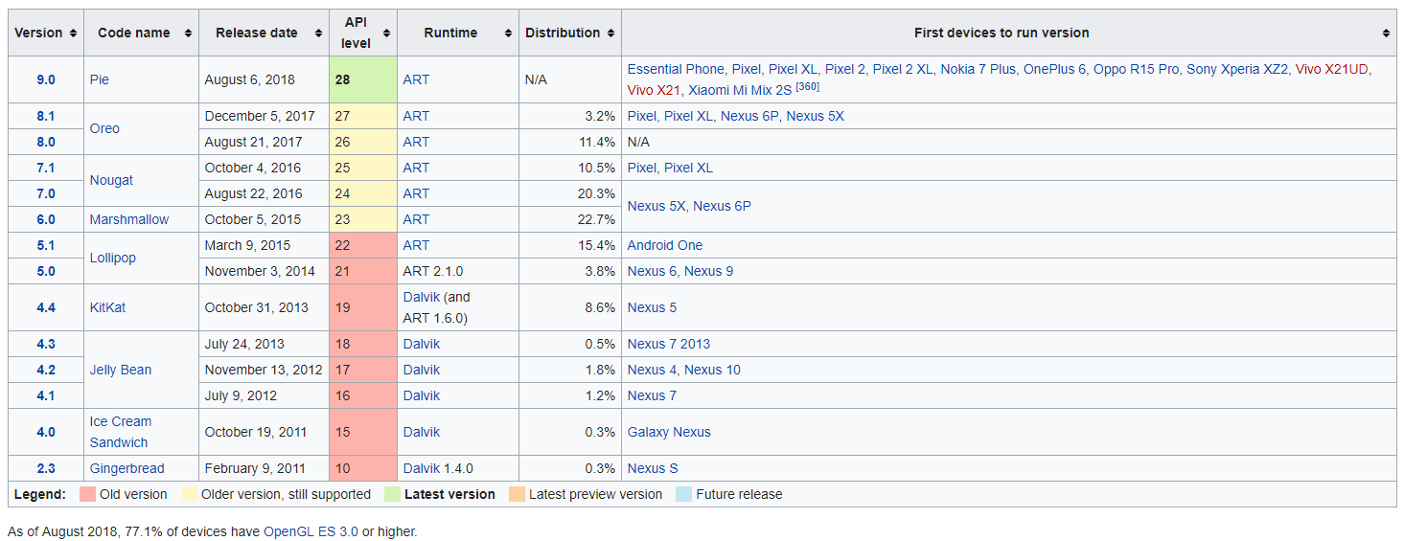
1.1 Android OS - The World’s Leading Mobile OS
Notes:
1. http://www.idc.com/prodserv/smartphone-os-market-share.jsp.
2. http://www.cnet.com/news/android-shipments-exceed-1-billion-for-first-time-in-
2014/.
3. http://www.pcworld.com/article/2896196/windows-forecast-to-gradually-grab-tabletmarket-
share-from-ios-and-android.html.
4. http://www.businessweek.com/articles/2013-05-29/behind-the-internet-of-things-isandroid-
and-its-everywhere.

Slide 11
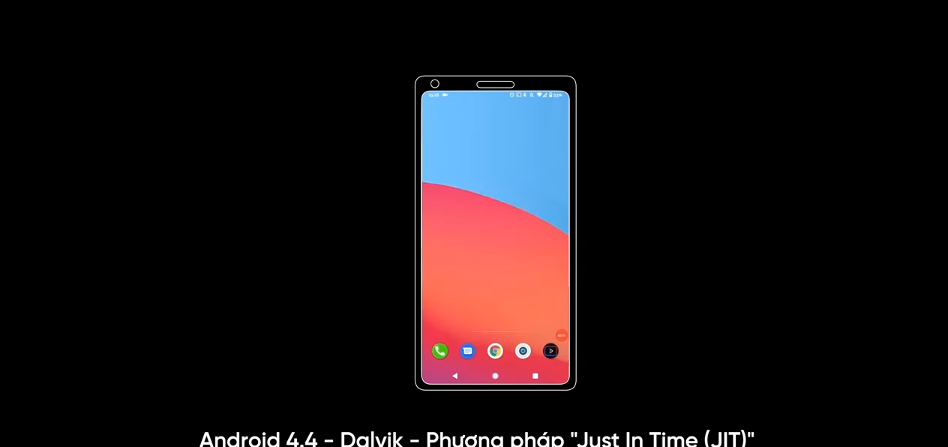
1.1 Android OS - The World’s Leading Mobile OS
Notes:
Dalvik -> Mỗi khi người dùng mở ứng dụng lên, mọi hành động, hình ảnh và tương tác chúng ta nhìn thấy đều được chạy qua lớp máy ảo Dalvik rồi mới xuống đến cấp hệ điều hành và phần cứng để xử lý, các thao tác phiên dịch này đều được diễn ra một cách liên tục, thuật ngữ gọi là JIT (Just in Time), xong sau đó phần biên dịch này nó lại bị xóa đi, để khi người dùng mở lên, quá trình biên dịch lại lặp lại từ đầu, đấy thế nó có phức tạp k cơ chứ, nghe thôi là cũng đã thấy cồng kềnh tốn tài nguyên rồi đúng k các em, thế nên thì hiện tượng chậm, đơ giật, lag là chuyện xảy ra đương nhiên mà mọi người vẫn truyền tai nhau cho đến tận năm 2020 này đấy.

Slide 12
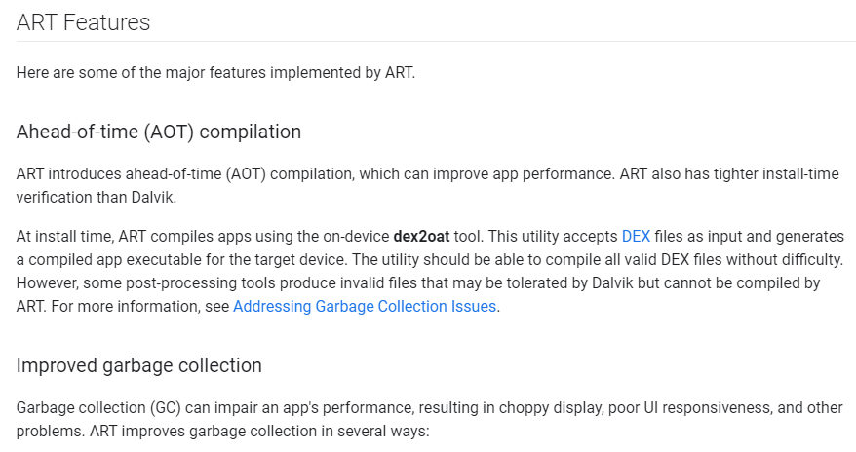
1.1 Android OS - The World’s Leading Mobile OS
Notes:
Nhưng kể từ năm 2014, Google đã chính thức cho trình máy ảo Dalvik chậm chạp nghỉ hưu và thay thế đó bằng ART (Android Runtime) sử dụng một phương pháp phiên dịch hoàn toàn mới, ưu điểm của ART chính là thay vì thay vì ứng dụng chạy đến đâu thì phiên dịch đến đó như là Dalvik thì ART sử dụng một phương pháp gọi là Ahead of Time (AOT) compilation

Slide 13
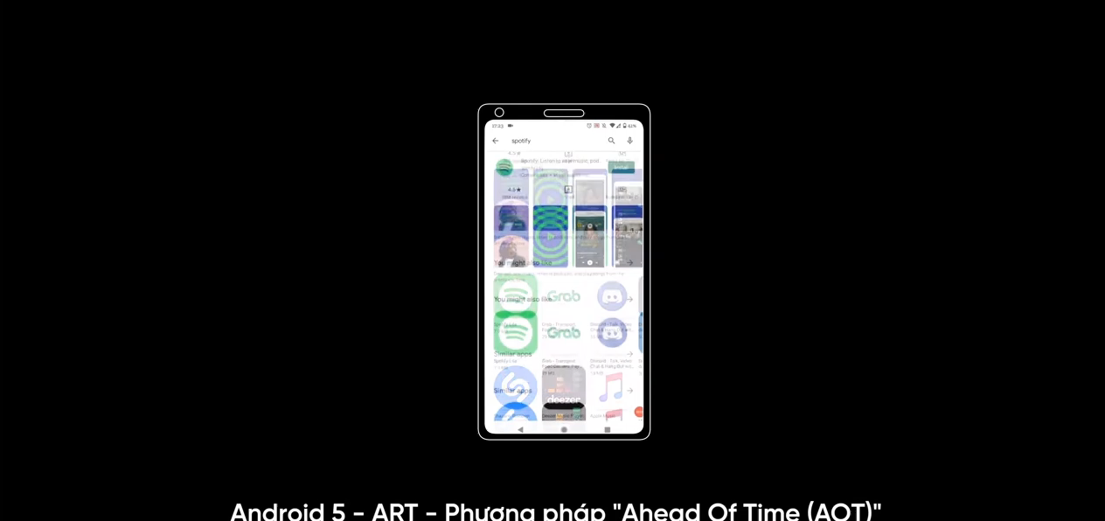
1.1 Android OS - The World’s Leading Mobile OS
Notes:
Phương pháp AOT này sẽ dịch hết toàn bộ ứng dụng ngay từ giai đoạn cài đặt ban đầu sang ngôn ngữ mà hệ điều hành có thể hiểu được và lưu luôn vào bộ nhớ, một 1 lần rồi xong luôn thay vì mất công phiên dịch đi rồi phiên dịch lại như là ứng dụng ngày trước nữa,
Để dễ hiểu thì Phương pháp JIT của Dalvik giống như là một người đang phiên dịch cho nguyên thủ quốc gia đi, 2 vị thủ tướng nói đến đâu thì Dalvik phiên dịch đến đó, còn AOT thì giống dịch sách, dịch 1 lần ghi ra giấy là có đọc bất kỳ lúc nào
-> Đây rõ rang là một bước tiến rất là lớn của Android, và nó bắt đầu cho những bước tiến tiếp theo để giúp Android đuổi kịp hơn về iOS về sự mượt cũng như độ mượt mà trong quá trình sử dụng ứng dụng
-> Thậm chí theo 1 vài nguồn tin thì phương pháp AOT còn được chính Apple copy lại, và Apple có ý định chạy những ứng dụng x86 trên những mẫu máy Mac ARM sắp tới

Slide 14
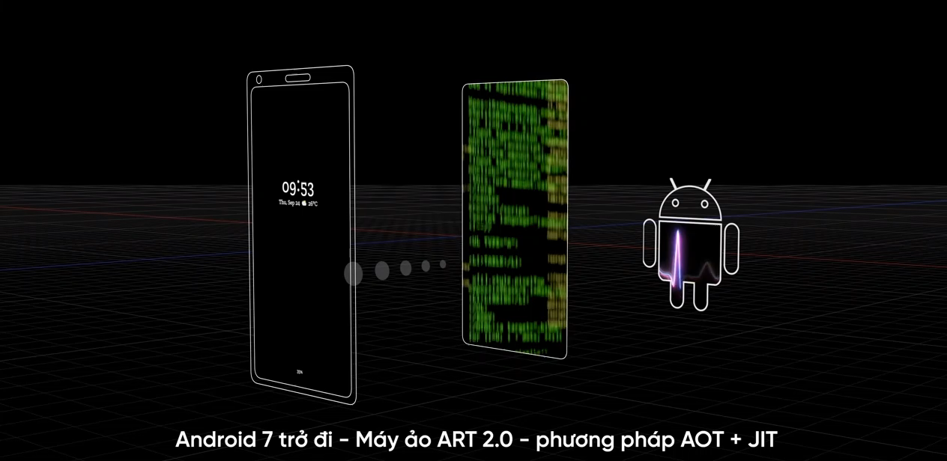
1.1 Android OS - The World’s Leading Mobile OS
Notes:
-> Ko chỉ vậy, Google còn ngày càng cải tiến Android khiến cho nó ngày càng thông minh và biến ảo hơn nhiều kể từ phiên bản Android 7 trở đi
-> Ngày xưa mỗi khi mua máy về cài đặt ứng dụng mở máy lên thì nó hơi lag lag và hao pin, phải mất một thời gian thì máy mới dần dần ổn định lại được, đó chính là bởi ở Android 5 thì ART phải biên soạn và lưu toàn bộ vào bộ nhớ ở ngay thời điểm ban đầu, -> tốn bộ nhớ -> cài đặt ứng dụng lâu hơn -> do máy hoạt động rất nhiều ở thời điểm ban đầu ->máy chậm giật lag, sau mới ổn định
-> Ngay từ phiên bản Android 7, Android áp dụng cả 2 PP JIT Andoid 4.4 về trước, AOT Android 5, cụ thể khi người dùng k dùng máy nữa, Android sẽ liên tục tự động chạy ngầm và biên dịch trước một vài thành phần quan trọng của các ứng dụng theo cách AOT của ART hiện tại, ngược lại những thành phần ít quan trọng hơn thì sẽ được biên soạn theo cách JIT trước kia của Dalvik
-> Thậm chí, AI của GG tích hợp vào Android còn thông minh hơn nữa, trong suốt quá trình sử dụng, nó sẽ quyết định xem là
ứng dụng nào người dung sử dụng thường xuyên thì nó sẽ được biên soạn AOT trước để tiết kiệm thời gian khởi đông vào ứng dụng,
ứng dụng nào người dung ít sử dụng thì nó sẽ dọn dẹp bớt bộ nhớ đi và sử dụng JIT nhiều hơn
-> Kết quả là khi mọi thứ nó k lưu bừa bãi nữa thì người dung sẽ có ngày càng nhiều bộ nhớ để lưu trữ ảnh, video, và ứng dụng Android đời mới lúc nào nó cũng sẽ mượt mà hơn, tất nhiên cũng sẽ kết hợp với các yếu tố phần cứng như: độ nhạy cảm ứng, phần mềm tối ưu làm sao thì mới tạo được một cái sự nhay, một cái sự mượt mà tổng thể được.
-> Máy ảo Android h đã hiện tại hơn rất nhiều.

Slide 15
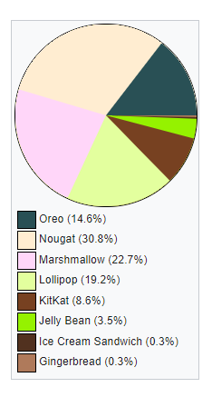
1.1 Android OS - The World’s Leading Mobile OS
Notes:
1. http://www.idc.com/prodserv/smartphone-os-market-share.jsp.
2. http://www.cnet.com/news/android-shipments-exceed-1-billion-for-first-time-in-
2014/.
3. http://www.pcworld.com/article/2896196/windows-forecast-to-gradually-grab-tabletmarket-
share-from-ios-and-android.html.
4. http://www.businessweek.com/articles/2013-05-29/behind-the-internet-of-things-isandroid-
and-its-everywhere.
5. http://www.telecompetitor.com/mobile-app-forecast-calls-for-revenue-of-99-
billion-by-2019/.

Slide 16
1.1 Android OS - The World’s Leading Mobile OS
Google Play category | Some popular apps in the category
Books and Reference Business Communication Education Entertainment Finance Games Health & Fitness | WolframAlpha, Dictionary.com, Audible for Android, Kindle Polaris Office, OfficeSuite 8, QuickBooks Online, PayPal Here Snapchat, LinkedIn, Pinterest, Instagram, WeChat, Line Google Classroom, Star Tracker, Sight Words, Math Tricks Showtime Anytime, History Channel, Discovery Channel PayPal, Credit Karma, Google Wallet, Chase Mobile Pac-Man 256, Angry Birds 2, Fruit Ninja, Tetris, Solitaire RunKeeper, ViewRanger GPS, Calorie Counter
Notes:
1. http://www.idc.com/prodserv/smartphone-os-market-share.jsp.
2. http://www.cnet.com/news/android-shipments-exceed-1-billion-for-first-time-in-
2014/.
3. http://www.pcworld.com/article/2896196/windows-forecast-to-gradually-grab-tabletmarket-
share-from-ios-and-android.html.
4. http://www.businessweek.com/articles/2013-05-29/behind-the-internet-of-things-isandroid-
and-its-everywhere.
5. http://www.telecompetitor.com/mobile-app-forecast-calls-for-revenue-of-99-
billion-by-2019/.

Slide 17
1.1 Android OS - The World’s Leading Mobile OS
Google Play category | Some popular apps in the category
Lifestyle Live Wallpaper Media & Video Medical Feed Music & Audio News & Magazines Photography Social | Assistant, Horoscope, Food Network, Starbucks Facebook, Next Launcher 3D Shell, Weather Live VHS Camera Recorder, VivaVideo Pro, musical.ly, GIF Keyboard Baby Pro, CareZone, FollowMyHealth, Essential Anatomy SoundCloud, Spotify, Beats Music, Pandora, iHeartRadio BBC News, CBS News, NPR News, Reuters, NBC News Google Camera, Instagram, Retrica, GoPro App, Pencil Sketch Snapchat, Instagram, Meetup, textPlus, Pinterest, Tumblr
Notes:
1. http://www.idc.com/prodserv/smartphone-os-market-share.jsp.
2. http://www.cnet.com/news/android-shipments-exceed-1-billion-for-first-time-in-
2014/.
3. http://www.pcworld.com/article/2896196/windows-forecast-to-gradually-grab-tabletmarket-
share-from-ios-and-android.html.
4. http://www.businessweek.com/articles/2013-05-29/behind-the-internet-of-things-isandroid-
and-its-everywhere.
5. http://www.telecompetitor.com/mobile-app-forecast-calls-for-revenue-of-99-
billion-by-2019/.

Slide 18
1.1 Features of Android
Openness and Open Source
One benefit of developing Android apps is the openness of the platform. The operating system is open source and free. This allows you to view Android’s source code and see how its features are implemented. You can contribute to Android by reporting bugs:
http://source.android.com/source/report-bugs.html
or by participating in the Open Source Project discussion groups
http://source.android.com/community/index.html
Numerous open-source Android apps from Google and others are available on the Internet. Figure below shows you where you can get the Android source code, learn about the philosophy behind the open-source operating system and get licensing information.

Slide 19
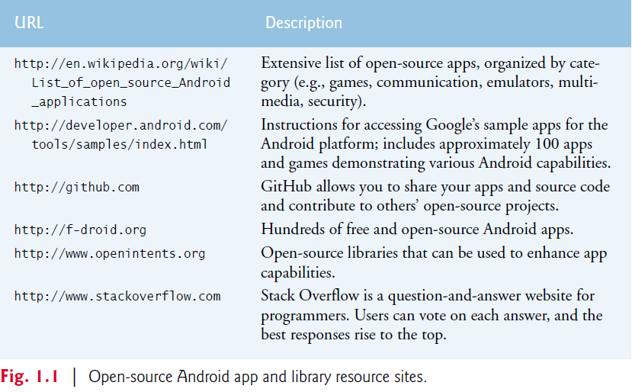
1.1 Features of Android

Slide 20
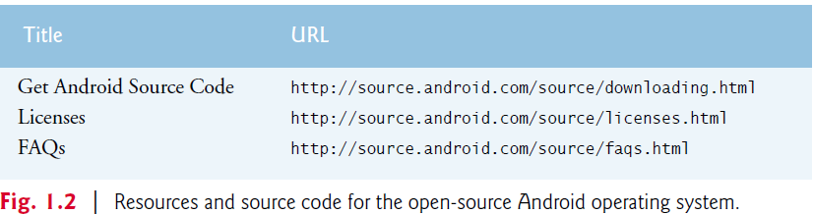
1.1 Features of Android

Slide 21
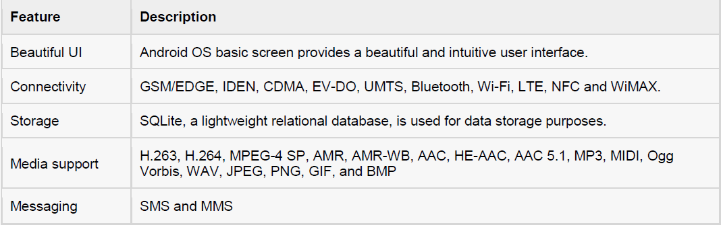
1.1 Features of Android
Notes:
Java
Android apps are developed with Java—one of the world’s most widely used programming
languages. Java was a logical choice for the Android platform, because it’s powerful, free,
open source and used by millions of developers. Experienced Java programmers can quickly
dive into Android development, using Google’s Android APIs (Application Programming
Interfaces) and others available from third parties.
Java is object oriented and has access to extensive class libraries that help you quickly
develop powerful apps. GUI programming in Java is event driven—in this book, you’ll
write apps that respond to various user-initiated events such as screen touches. In addition
to directly programming portions of your apps, you’ll also use the Android Studio IDE to
conveniently drag and drop predefined objects such as buttons and textboxes into place
on your screen, and label and resize them. Using Android Studio, you can create, run, test
and debug Android apps quickly and conveniently.
Multitouch Screen
Android smartphones wrap the functionality of a mobile phone, Internet client, MP3
player, gaming console, digital camera and more into a handheld device with full-color
multitouch screens. With the touch of your fingers, you can navigate easily between using
your phone, running apps, playing music, web browsing and more. The screen can display
a keyboard for typing e-mails and text messages and entering data in apps (some Android
devices also have physical keyboards).
Gestures
The multitouch screens allow you to control the device with gestures involving one touch
or multiple simultaneous touches (Fig. 1.3).
Touch Tap the screen once. Open an app, “press” a button or a menu
item.
Double touch Tap the screen twice. Zoom in on pictures, Google Maps and web
pages. Tap the screen twice again to zoom
back out.
Long press Touch the screen and hold
your finger in position.
Select items in a view—for example, checking
an item in a list.
Swipe Touch the screen, then move
your finger in the swipe
direction and release.
Flip item-by-item through a series, such as
photos. A swipe automatically stops at the
next item.
Drag Touch and drag your finger
across the screen.
Move objects or icons, or scroll through a
web page or list.
Pinch zoom Pinch two fingers together,
or spread them apart.
Zoom in and out on the screen (e.g., resizing
text and pictures).
Built-in Apps
Android devices come with several default apps, which may vary, depending on the device,
the manufacturer or the mobile service carrier. Some apps commonly included are Phone,
Contacts, Messenger, Browser, Calculator, Calendar, Clock and Photos.
Web Services
Web services are software components stored on one computer that can be accessed by an
app (or other software component) on another computer over the Internet. With web services,
you can create mashups, which enable you to rapidly develop apps by quickly combining
complementary web services, often from different organizations and possibly other
forms of information feeds. For example, 100 Destinations

Slide 22
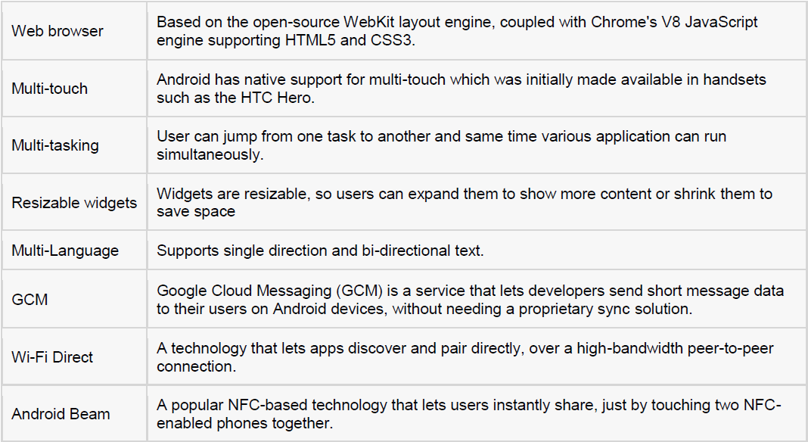
1.1 Features of Android

Slide 23
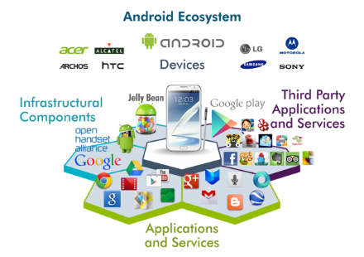
1.2 Android và hệ sinh thái
Ecosystem

Slide 24
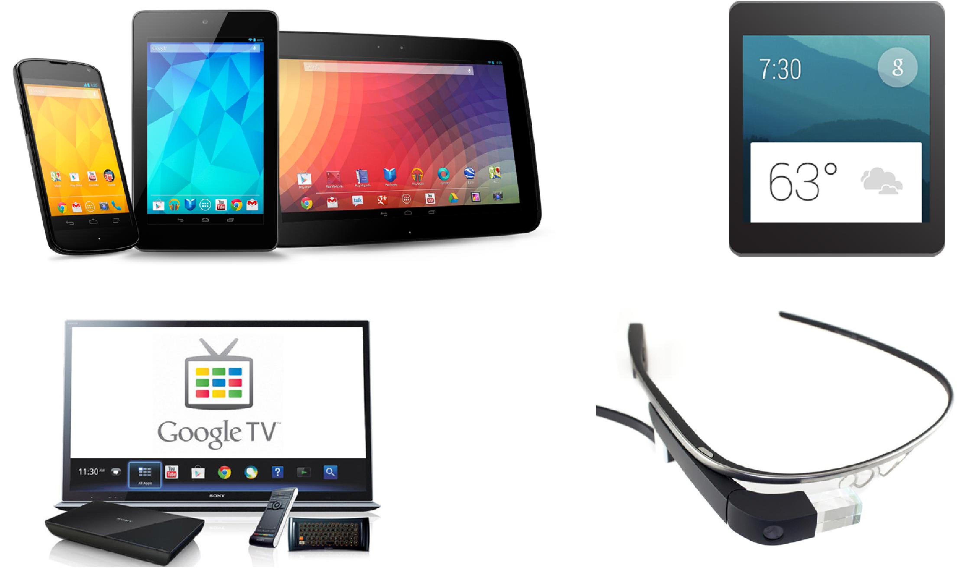
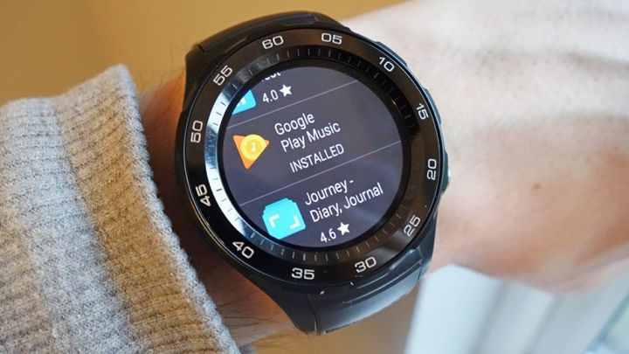
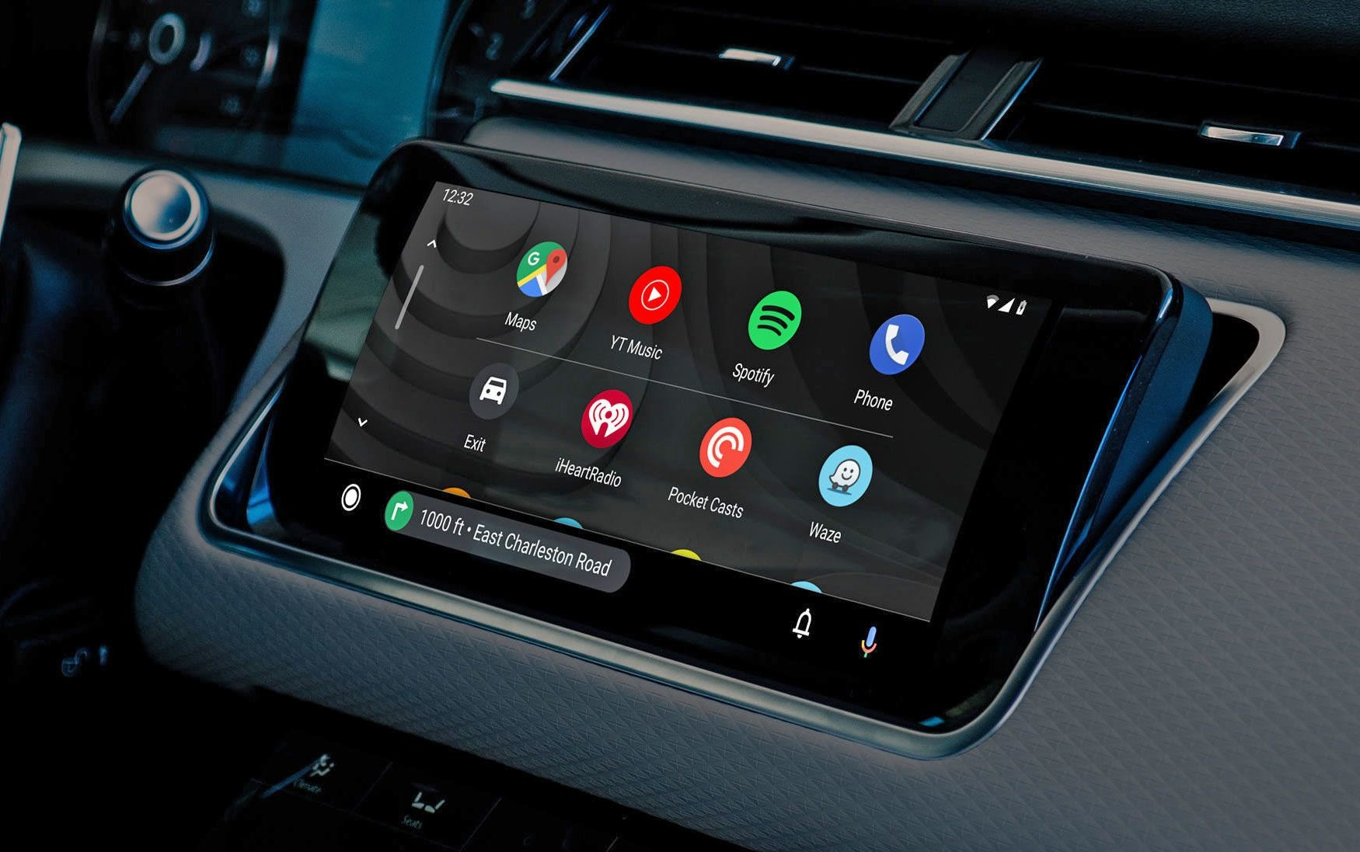
1.2 Android và hệ sinh thái
Ecosystem
Notes:
Fun fact of Android
http://phandroid.com/2015/02/05/10-surprising-android-facts/
http://www.spinfold.com/15-less-known-facts-about-android/
https://www.youtube.com/watch?v=aUbep5S_SFM
Android applications are usually developed in the Java language using the Android Software Development Kit.
Once developed, Android applications can be packaged easily and sold out either through a store such as Google Play or the Amazon Appstore.
Android powers hundreds of millions of mobile devices in more than 190 countries around the world. It's the largest installed base of any mobile platform and growing fast. Every day more than 1 million new Android devices are activated worldwide.

Slide 25
Outline
Introduction
Android Architecture
Component
Software Architecture
Programming Language
Android Application Development
Hello World

Slide 26
2.1 Component
Android based on Linux kernel 2.6, from version 4.0 using Linux kernel 3.x.
Android includes 3 main components:
Middleware
Libraries and API written in C
Executable Application written in Java
Dalvik Virtual Machine which is a kind of Java Virtual Machine specially designed and optimized for Android.

Slide 27
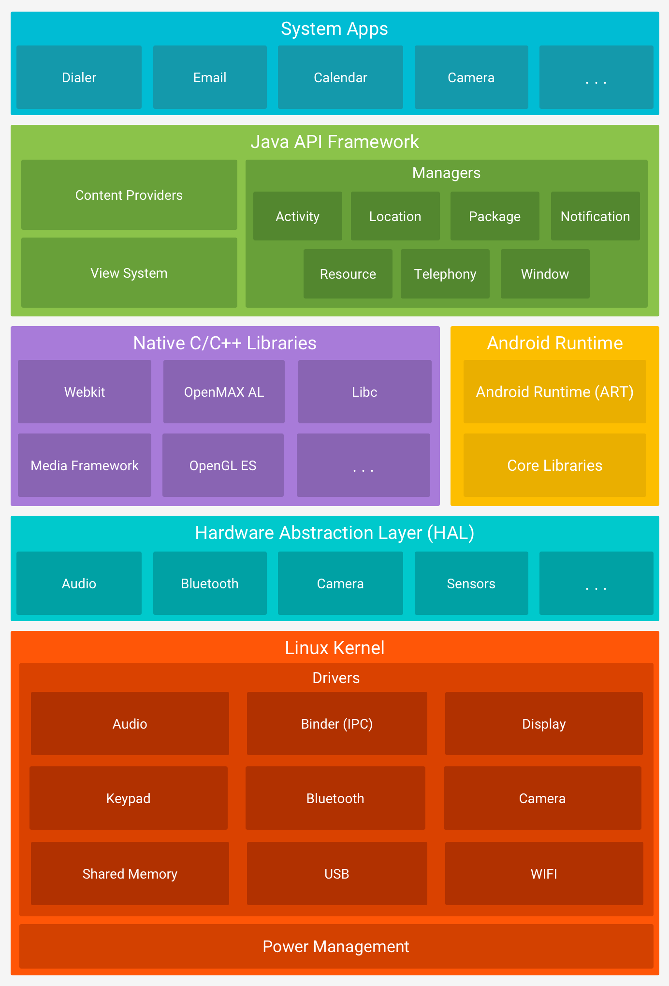
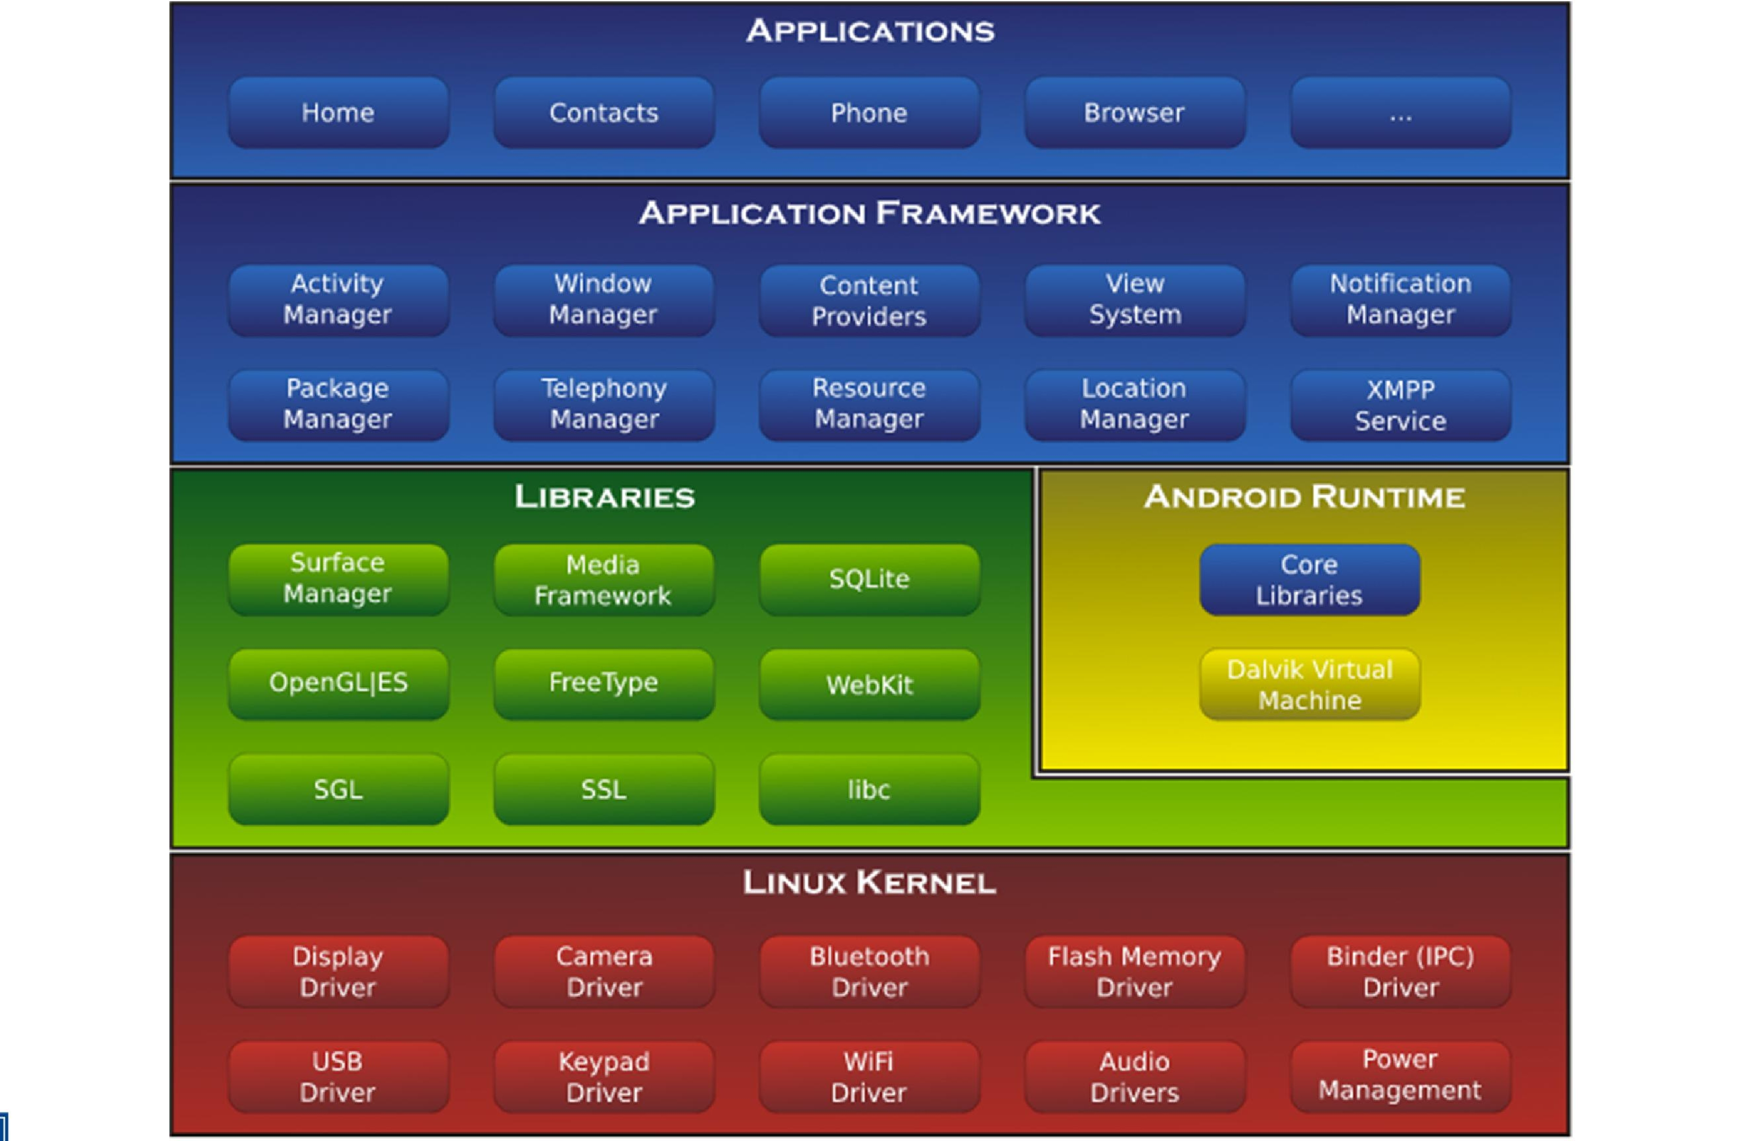
2.2 Architecture
Notes:
https://developer.android.com/guide/platform

Slide 28
2.3 Programming Language
Programming Language can be used:
Java
● C/C++
JNI
XML
Render Script
Kotlin

Slide 29
Outline
Introduction
Android Architecture
Android Appication Development
Android Developer Tools Bundle
Android Studio
Hello World

Slide 30

3.1 Android Developer Tools Bundle
Android Developer Tools Bundle (ADT) bao gồm:
Eclipse + ADT plugin
Android SDK Tools
Android Platform Tools
Android Versions
Android Emulator

Slide 31
3.2 Android Studio
Android Studio is the official IDE for Android application development, based on IntelliJ IDEA. On top of the capabilities you expect from IntelliJ, Android Studio offers:
Flexible Gradle-based build system.
Build variants and multiple apk file generation
Code templates to help you build common app features
Rich layout editor with support for drag and drop theme editing
lint tools to catch performance, usability, version compatibility, and other problems
Built-in support for Google Cloud Platform, making it easy to integrate Google Cloud Messaging and App Engine.
And much more

Slide 32
Outline
Introduction
Android Architecture
Android Application Development
Hello World
Create and Android project
Project Explorer
AndroidManifest
Android AVD and Application Installing

Slide 33
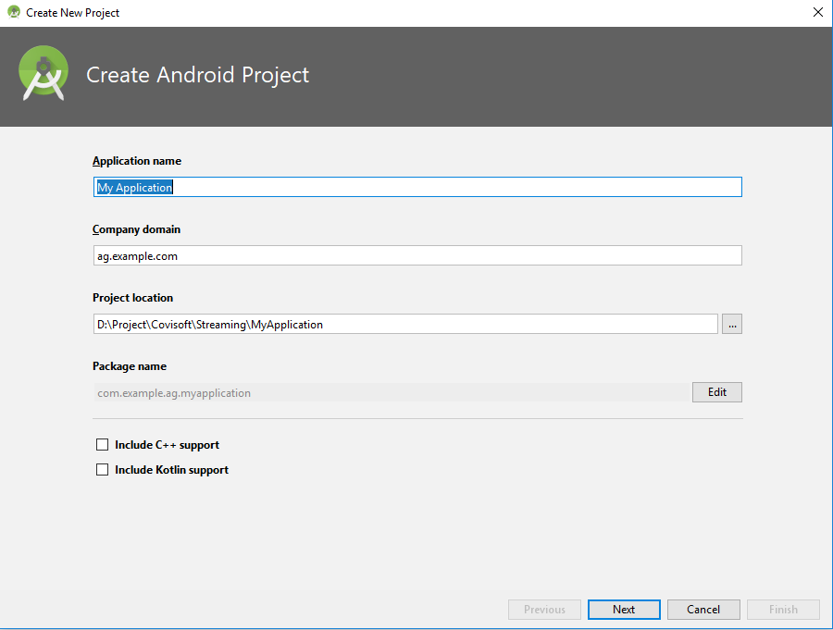
4.1 Create an Android Project
In Android Studio, create a new project:
If you don't have a project opened, in the Welcome screen, click New Project.
If you have a project opened, from the File menu, select New Project.
Under Configure your new project, fill in the fields as shown in figure 1 and click Next.

Slide 34
4.2 Project Explorer
Your Android project is now a basic "Hello World" app that contains some default files. Take a moment to review the most important of these:
app/src/main/res/layout/activity_my.xml
app/src/main/java/com.mycompany.myfirstapp/MyActivity.java
app/src/main/AndroidManifest.xml
app/build.gradle
/res
drawable<density>/
layout/
menu/
values/

Slide 35
4.3 AndroidManifest
Every application must have an AndroidManifest.xml file in its root directory. The manifest does the following:
It names the Java package for the application. The package name serves as a unique identifier for the application.
Example: com.example.tuananh.myfirstapp
It determines which processes will host application components.
It declares which permissions the application must have in order to access protected parts of the API and interact with other applications.
It also declares the permissions that others are required to have in order to interact with the application's components.
It declares the minimum level of the Android API that the application requires.
It lists the libraries that the application must be linked against.

Slide 36
4.4 Android AVD
Create an AVD:
run Android Virtual Machine Manager.
Select New and fill in the blanks:
AVD Name
Device
Target: OS Version
CPU/ABI: chipset
Keyboard
Skin: screen size
Front Camera/ Back Camera: camera
Memory Options: RAM and HEAP
Internal Storage
SDCard: size in sdcard
Emulation Options: GPU emulation
Press Ok to finish
Select and AVD → Start.

Slide 37
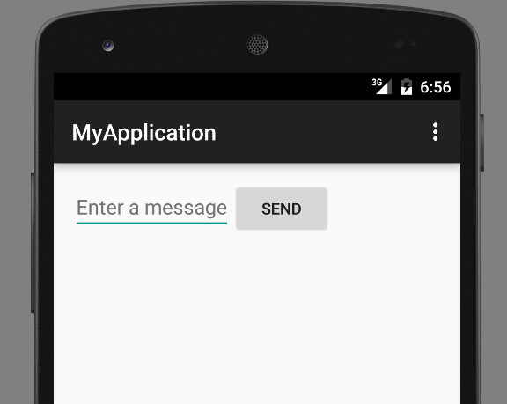
4.4 Android AVD
Install Application:
Open an project.
Right click → Run As → Android Application.
Select and AVD.
Console output.

Slide 38
4.5 Building Great Android Apps
With over 2.8 million apps in Google Play, how do you create an Android app that people will find, download, use and recommend to others?
Notes:
Consider what makes an app fun, useful, interesting, appealing and enduring. A clever app name, an attractive icon and an
engaging description might lure people to your app on Google Play or one of the many
other Android app marketplaces. But once users download the app, what will make them
use it regularly and recommend it to others? Figure 1.27 shows some characteristics of
great apps.

Slide 39
4.5 Building Great Android Apps
Great Games
• Entertaining and fun.
• Challenging.
• Progressive levels of difficulty.
• Show your scores and use leaderboards to record high scores.
• Provide audio and visual feedback.
• Offer single-player, multiplayer and networked versions.
• Have high-quality animations.
• Offloading input/output and compute-intensive code to separate threads of execution
to improve interface responsiveness and app performance.
• Innovate with augmented reality technology—enhancing a real-world environment
with virtual components; this is particularly popular with video-based apps.
Notes:
Consider what makes an app fun, useful, interesting, appealing and enduring. A clever app name, an attractive icon and an
engaging description might lure people to your app on Google Play or one of the many
other Android app marketplaces. But once users download the app, what will make them
use it regularly and recommend it to others? Figure 1.27 shows some characteristics of
great apps.

Slide 40
4.5 Building Great Android Apps
Useful Utilities
• Provide useful functionality and accurate information.
• Increase personal and business productivity.
• Make tasks more convenient (e.g., maintaining a to-do list, managing expenses).
• Make the user better informed.
• Provide topical information (e.g., the latest stock prices, news, severe-storm warnings,
traffic updates).
• Use location-based services to provide local services (e.g., coupons for local businesses,
best gas prices, food delivery).
Notes:
Consider what makes an app fun, useful, interesting, appealing and enduring. A clever app name, an attractive icon and an
engaging description might lure people to your app on Google Play or one of the many
other Android app marketplaces. But once users download the app, what will make them
use it regularly and recommend it to others? Figure 1.27 shows some characteristics of
great apps.

Slide 41
4.5 Building Great Android Apps
General Characteristics
• Up-to-date with the latest Android features, but compatible with multiple Android versions
to support the widest possible audience.
• Work properly.
• Bugs are fixed promptly.
• Follow standard Android app GUI conventions.
• Launch quickly.
• Are responsive.
Notes:
Consider what makes an app fun, useful, interesting, appealing and enduring. A clever app name, an attractive icon and an
engaging description might lure people to your app on Google Play or one of the many
other Android app marketplaces. But once users download the app, what will make them
use it regularly and recommend it to others? Figure 1.27 shows some characteristics of
great apps.

Slide 42
4.5 Building Great Android Apps
General Characteristics (cont)
• Don’t require excessive memory, bandwidth or battery power.
• Are novel and creative.
• Enduring—something that your users will use regularly.
• Use professional-quality icons that will appear in Google Play and on the user’s device.
• Use quality graphics, images, animations, audio and video.
• Are intuitive and easy to use (don’t require extensive help documentation).
• Accessible to people with disabilities (http://developer.android.com/guide/topics/
ui/accessibility/index.html).
• Give users reasons and a means to tell others about your app (e.g., you can give users the
option to post their game scores to Facebook or Twitter).
Notes:
Consider what makes an app fun, useful, interesting, appealing and enduring. A clever app name, an attractive icon and an
engaging description might lure people to your app on Google Play or one of the many
other Android app marketplaces. But once users download the app, what will make them
use it regularly and recommend it to others? Figure 1.27 shows some characteristics of
great apps.

Slide 43
4.5 Building Great Android Apps
General Characteristics (cont)
• Provide additional content for content-driven apps (e.g., game levels, articles, puzzles).
• Localized (Chapter 2) for each country in which the app is offered (e.g., translate the
app’s text and audio files, use different graphics based on the locale, etc.).
• Offer better performance, capabilities and ease-of-use than competitive apps.
• Take advantage of the device’s built-in capabilities.
• Do not request excessive permissions.
• Are designed to run optimally across a broad variety of Android devices.
• Future-proofed for new hardware devices—specify the exact hardware features your app
uses so Google Play can filter and display it in the store for only compatible devices
(http://android-developers.blogspot.com/2010/06/future-proofing-yourapp.
html).
Notes:
Consider what makes an app fun, useful, interesting, appealing and enduring. A clever app name, an attractive icon and an
engaging description might lure people to your app on Google Play or one of the many
other Android app marketplaces. But once users download the app, what will make them
use it regularly and recommend it to others? Figure 1.27 shows some characteristics of
great apps.

Slide 44
4.6 Android Development Resources
App Components http://developer.android.com/guide/components/index.html
Using the Android Emulator http://developer.android.com/tools/devices/emulator.html
Package Index http://developer.android.com/reference/packages.html
Class Index http://developer.android.com/reference/classes.html
Android Design http://developer.android.com/design/index.html
Data Backup http://developer.android.com/guide/topics/data/backup.html
Security Tips http://developer.android.com/training/articles/securitytips.
html
Android Studio http://developer.android.com/sdk/index.html
Debugging http://developer.android.com/tools/debugging/index.html
Tools Help http://developer.android.com/tools/help/index.html
Performance Tips http://developer.android.com/training/articles/perftips.
html
Notes:
Consider what makes an app fun, useful, interesting, appealing and enduring. A clever app name, an attractive icon and an
engaging description might lure people to your app on Google Play or one of the many
other Android app marketplaces. But once users download the app, what will make them
use it regularly and recommend it to others? Figure 1.27 shows some characteristics of
great apps.

Slide 45
4.6 Android Development Resources
Keeping Your App Responsive http://developer.android.com/training/articles/perfanr.html
Launch Checklist (for Google Play)
http://developer.android.com/distribute/tools/launchchecklist.html
Getting Started with Publishing
http://developer.android.com/distribute/googleplay/start.html
Managing Your App’s Memory http://developer.android.com/training/articles/memory.html
Google Play Developer Distribution Agreement
http://play.google.com/about/developer-distributionagreement.html
Notes:
Consider what makes an app fun, useful, interesting, appealing and enduring. A clever app name, an attractive icon and an
engaging description might lure people to your app on Google Play or one of the many
other Android app marketplaces. But once users download the app, what will make them
use it regularly and recommend it to others? Figure 1.27 shows some characteristics of
great apps.

Slide 46
References
http://developer.android.com/sdk/index.html
http://developer.android.com/training/index.html
http://www.tutorialspoint.com/android/index.htm
http://www.openhandsetalliance.com/
http://www.android.com/

Slide 47
Kotlin vs Java for Android: key differences
What is JAVA?
Java is an OOP (object-oriented programming) language which came to usage in 1995. Java was developed at sun microsystems which later acquired by Oracle. If we want to run a Java program on the browser we need to use Java applets which are embedded as a plugin which is not suggested. So Java is mostly used for standalone applications or back-end development. Java was designed by James Gosling and its major implementation was OpenJDK. Java is the primary choice for most of the developers when it comes to Android application development as Android itself is written in Java.

Slide 48
Kotlin vs Java for Android: key differences
What is KOTLIN?
Kotlin is a new programming language developed by programmers from IDE Jet Brains which handles some modern features to it. It has first appeared in the year 2011 and the official release in 2016 and it is an open-source language. Kotlin is also a statically typed programming language like Java, C++, which based on JVM (Java Virtual Machine) but it can be compiled to JavaScript, Android and Native also for building code and run on iOS. Kotlin is fully compatible with existing Java stacks with a smooth learning curve. Switching from Java to Kotlin is very easy as we just need to install a Plugin. During the Google I/O keynote, it announced that they making Kotlin an officially supported language for Android application development.

Slide 49
Kotlin vs Java for Android: key differences
Kotlin vs Java, the latter offers more succinct code – with no findViewByIds
JAVA
import kotlinx.android.synthetic.main.activity_main.textView
textView.setText("Hello World")
TextView text = (TextView) findViewById(R.id.textView); text.setText("Hello World");
Notes:
https://www.androidauthority.com/kotlin-vs-java-783187/
If you compare a Kotlin class and a Java class that are performing the same work, then the Kotlin class will generally be much more concise, but there’s one area in particular where Kotlin can seriously reduce the amount of boilerplate code you need to write: findViewByIds.
Kotlin Android Extensions allow you to import a reference to a View into your Activity file, at which point you’ll be able to work with that View as though it was part of the Activity. The result? You’ll never have to write another findViewById method again!
Before you can use these extensions, you’ll need to add an extra plugin to your module-level build.gradle file (apply plugin: ‘kotlin-android-extensions’) but after that, you’re ready to start importing Views. For example, if your activity_main.xml file contained a TextView with the ID textView, then you’d add the following to your Activity:

Slide 50
Kotlin vs Java for Android: key differences
Kotlin has the support of smart cast which identifies immutable types and performs implicit cast by compiler whereas in Java we need to identify and perform the casting.
Kotlin has the support of type inference which means we don’t need to specify the data type of variable explicitly whereas in Java we need to specify explicitly.
In Kotlin, we don’t have checked exceptions, which is a disadvantage as it leads to error prone-code whereas Java has support for checked exceptions by which we can perform error handling.
Java compilation time is 15-20% faster than Kotlin compilation time but in perspective of incremental build compilation, Kotlin will also take same compilation time as Java.
In Kotlin, we can’t assign null values to variables or return values, if we really want to assign then we can declare a variable with special syntax whereas in Java we can assign null values but when we try to access objects pointing to null values raises an exception.
Kotlin is interchangeable with Java irrespective of difference between Java vs Kotlin. We can call Kotlin code in Java and Java code in Kotlin. So we can have both Java vs Kotlin classes side by side in a project and compiles without any issues. After compilation we unable to find which class written in Java or Kotlin.
Notes:
https://www.educba.com/java-vs-kotlin/

Slide 51
Benefits of Kotlin Language
In the following aspects kotlin is a better language than Java for Android programming:
1. Kotlin compiles to JVM bytecode or JavaScript
2. Kotlin programs can use all existing Java Frameworks and Libraries
3. Kotlin can be learned easily
4. Kotlin is Open Source
5. Automatic conversion of Java to Kotlin
6. Kotlin’s null-safety is great
val name: String = null // tries to assign null, won’t compile.
fun getName(): String = null // tries to return null, won’t compile.
Notes:
https://www.xenonstack.com/blog/kotlin-andriod/

Slide 52
Benefits of Kotlin Language
/* Java Code */
class Book {
private String title;
private Author author;
public String getTitle() { return title; }
public void setTitle(String title) { this.title = title; }
public Author getAuthor() { return author; }
public void setAuthor(Author author) { this.author = author; }
}
/* kotlin Code */
data class Book(var title: String, var author: Author)
The Future of Kotlin language
Kotlin interworks with Java and provides incremental change of code and superior type system to Java and provides the easy Migration path from Java with backward compatibility.
With features Like more declarative, less code, mixed language database and more expressive than Java, Make Kotlin the future language for enterprises applications and Mobile.
Notes:
https://www.xenonstack.com/blog/kotlin-andriod/

Slide 53
Native Android Developer Roadmap
1, Programming
Java
Kotlin
2, Android studio
Android studio (install, update, overview).
Project structure.
Keyboard shortcut.
3, Android component
Activity (lifecycle, Task and backstack) >>> Fragment.
Service.
Broadcase Receiver.
Content Provider.
Notes:
https://roadmap.sh/android
https://github.com/mobile-roadmap/android-developer-roadmap
https://medium.com/mindorks/android-development-learning-path-2020-edition-3f464ac56dbf
https://github.com/MindorksOpenSource/android-developer-roadmap

Slide 54
Native Android Developer Roadmap
4, Intent
Intent (overview, type of Intent).
Intent Filter.
Pending Intent.
5, User interface
Static UI:
View: Button, ImageView, TextView, EditText...
ViewGroup: LinearLayout, RelaytiveLayout, FrameLayout, ConstraintLayout.
Dynamic UI:
RecyclerView.
ViewPage (ViewPager vs ViewPage2).
Spinner.
Note: AndroidX release cũng đã lâu nên chúng ta nên sử dụng Google material compoent để phù hợp với AndroidX.
Notes:
https://roadmap.sh/android
https://github.com/mobile-roadmap/android-developer-roadmap
https://medium.com/mindorks/android-development-learning-path-2020-edition-3f464ac56dbf
https://github.com/MindorksOpenSource/android-developer-roadmap

Slide 55
Native Android Developer Roadmap
6, CustomView
Canvas.
Bitmap.
Paint.
7, UI resources
Drawable.
String.
Styles.
Dimen...
8, Fragment
Fragment Lifecycle.
Fragment Manager, Fragment Transaction.
Single Activity.
9, Support User Interface
ProgressBar.
Dialogs.
Toast & Snackbar.
10, Storage
Shared Preferences.
File Systems.
Database — RoomDB
11, Build
Gradle.
Debug / Release Configuration.
Notes:
https://roadmap.sh/android
https://github.com/mobile-roadmap/android-developer-roadmap
https://medium.com/mindorks/android-development-learning-path-2020-edition-3f464ac56dbf
https://github.com/MindorksOpenSource/android-developer-roadmap

Slide 56
Native Android Developer Roadmap
12, Threading
Threads.
Handler / Looper.
13, Debugging
Memory profiling.
Logging.
Systrace.
Exceptions.
Error Handling.
14, Memory Leak
Detecting and Fixing Memory Leaks.
Context.
15, 3rd Party Library
Image Loading - Glide, Picasso.
Dependency Injection - Dagger, Koin.
Networking - Fast Android Networking Library, Retrofit.
MultiThreading - RxJava, Coroutines.
16, Data Format
JSON — GSON.
Flat Buffer.
Protocol Buffer.
Notes:
https://roadmap.sh/android
https://github.com/mobile-roadmap/android-developer-roadmap
https://medium.com/mindorks/android-development-learning-path-2020-edition-3f464ac56dbf
https://github.com/MindorksOpenSource/android-developer-roadmap

Slide 57
Native Android Developer Roadmap
17, Android Jetpack
Foundation Components — AppCompat, Android KTX, Multidex.
Architecture Components — LiveData, ViewModel, DataBinding, Paging, Work Manager, Navigation.
Behaviour Components - Download Manager, Media Playback, Notification, Permissions, Preference, Sharing, Slice.
UI Component - Animation & Transition, Android Auto, Emoji, Palette, Android TV, Android Wear.
18, Architecture
MVVM.
MVP.
19, Unit Testing
Local Unit Testing.
Instrumentation Testing.
20, Firebase
FCM.
Crashlytics.
Analytics.
Remote Config.
App Indexing.
Dynamic Link.
21, Security
Encrypt / Decrypt.
Proguard.
R8.
22, App Release
.keystore file.
App Bundle.
Playstore.
Notes:
Bài viết mình dựa vào bài post của Mindorks có chỉnh sửa 1 ít.
Và tất nhiên ai đã thông thạo hết những thứ này rồi thật sự rất đáng nể phục. Nếu chưa thì đặt nó làm mục tiêu để phấn đấu cũng rất có ít đó.
Trong quá trình học tập và làm việc sẽ có những lúc bạn cảm thấy không còn động lực hay lạc lối thì hãy dựa vào đó mà đi tiếp nhé.
Mình chắc chắn là chưa thể nào biết hết được những thứ đó rồi . Nhưng nếu bạn có đam mê với Android thì việc master nó sẽ đến rất nhanh thôi.
Happy coding.

Slide 58


QUESTIONS?

